Slide 1
National Key Performance Indicators:
Summary Report – Results Over Time
Bulgarr Ngaru - Bugalwena General Practice
Data Collection:
December 2024

Slide 2
Contents
Contents
1
Maternal and Child Health Summary
2
Preventative Health Summary
3
Chronic Disease Management Summary

Slide 3
Introduction
The National Key Performance Indicators (nKPIs) have been developed to support the monitoring of
major health issues affecting the regular client* population of Indigenous-specific primary health care
services. The nKPIs relate to the three themes of maternal and child health, preventative health, and
chronic disease management.
The nKPI information collected and provided back to health services is intended to be used to improve the delivery of primary health care services by supporting continuous quality improvement (CQI) activity among health service providers. At a broader level, the nKPI data will support policy and planning at the national and state/territory level and will be used to monitor progress and highlight areas for improvement. The nKPIs will also support the objective of closing the gap in life expectancy between Aboriginal and Torres Strait Islander and non-Indigenous Australians.
The nKPI collection comprises 14 ‘process of care’ indicators and 8 ‘health outcome’ indicators. The former group of indicators is largely under the control of health service organisations and indicate good practice in primary health care. Health outcomes are influenced by the work of primary health care; however they are also influenced by socio-economic factors such as education, employment, income and housing, which are beyond the immediate control of primary health care organisations.
* A regular client is defined as a client who has an active medical record- that is, a client who attended the Australian Government Department of Health-funded
or state and territory government-funded primary health care service at least 3 times in 2 years.

Slide 4
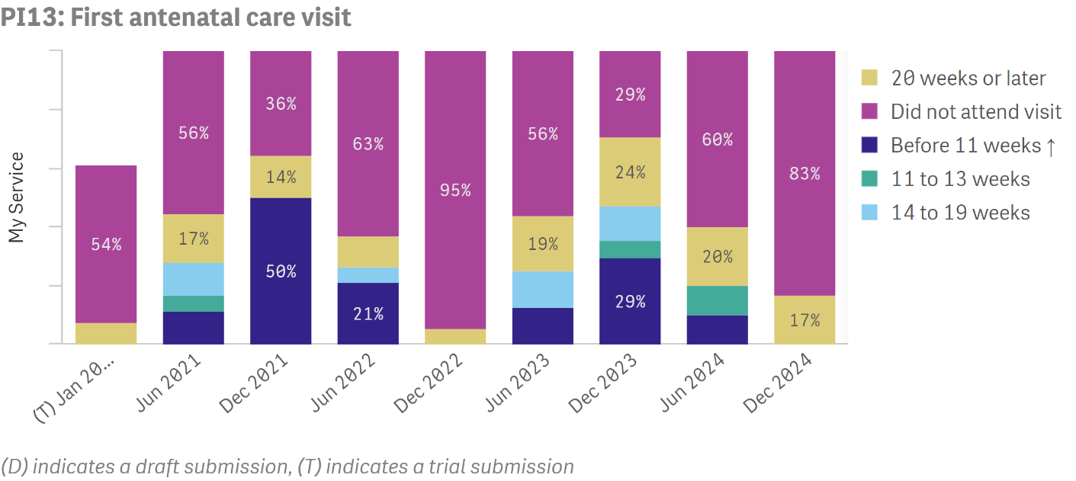
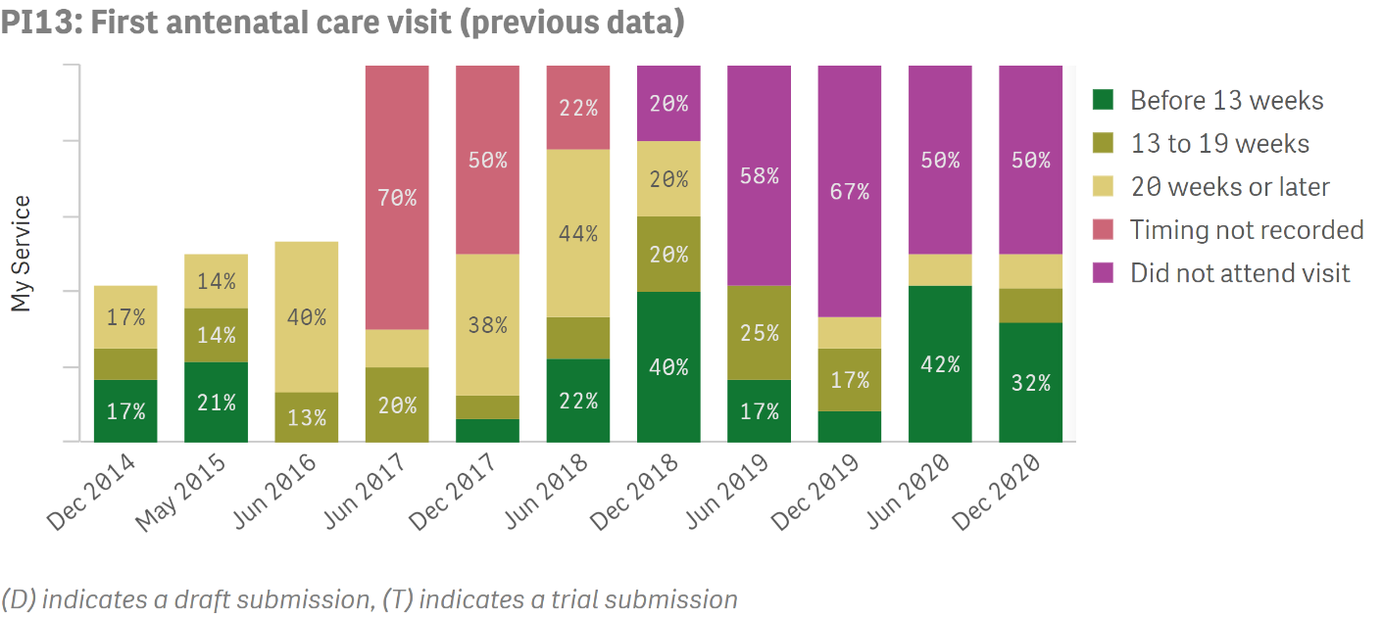
Maternal and Child Health Summary
Process of Care
Updates were made to this indicator in June 2021. This means that data up to December 2020 and data from June 2021 onwards are not directly comparable
PI13- latest data
Proportion of regular clients
who had their first antenatal
care visit within specified
periods.
PI13- previous data
Proportion of regular clients
who had their first antenatal
care visit within specified
periods.

Slide 5
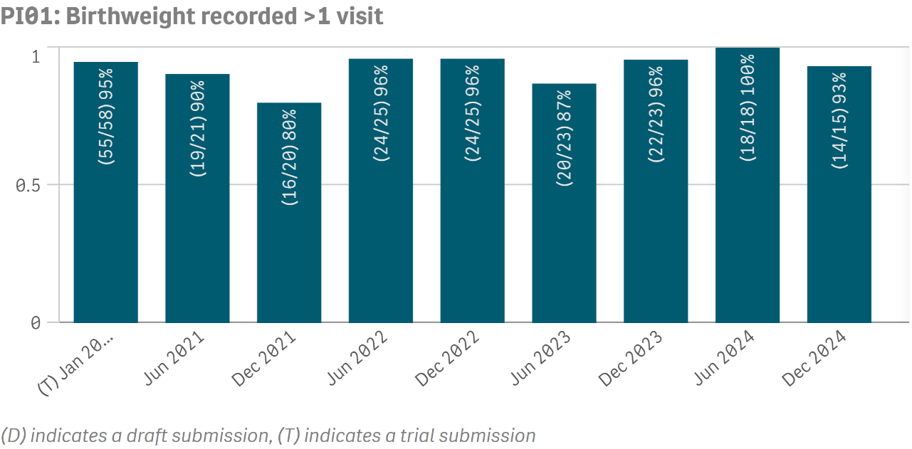
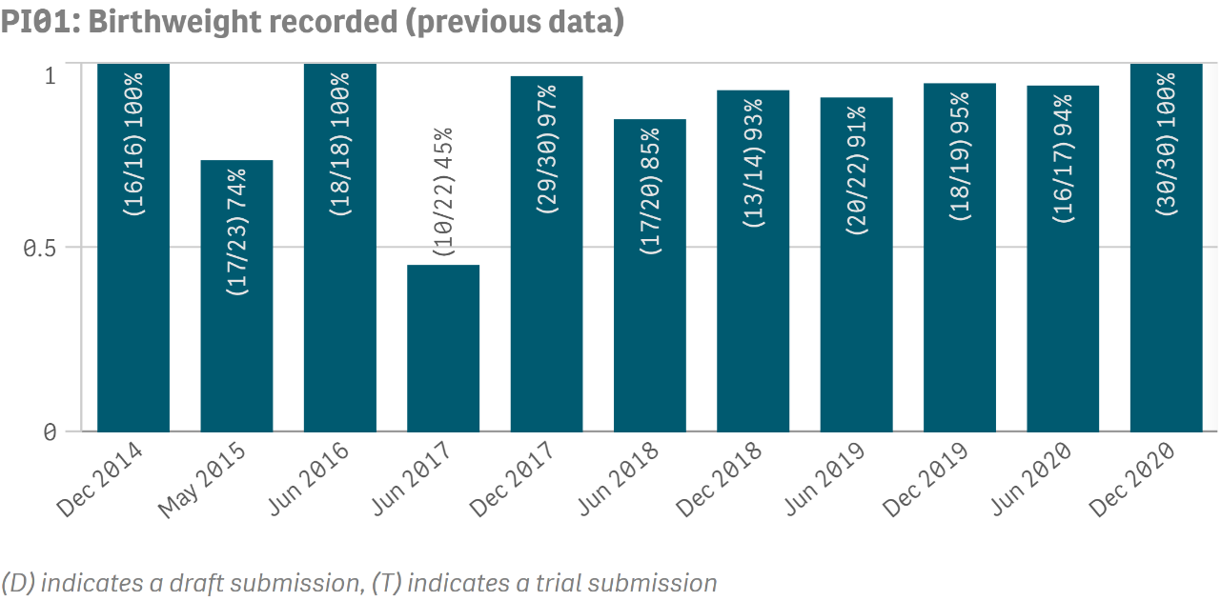
Maternal and Child Health Summary
Process of Care
Updates were made to this indicator in June 2021. This means that data up to December 2020 and data from June 2021 onwards are not directly comparable
PI01- latest data
Proportion of babies born
within the previous 12 months, who attended the organisation more than once, whose birthweight has been recorded.
A higher result is the preferred outcome
PI01- previous data
Proportion of babies born
within the previous 12 months whose birthweight has been recorded.
A higher result is the preferred outcome

Slide 6
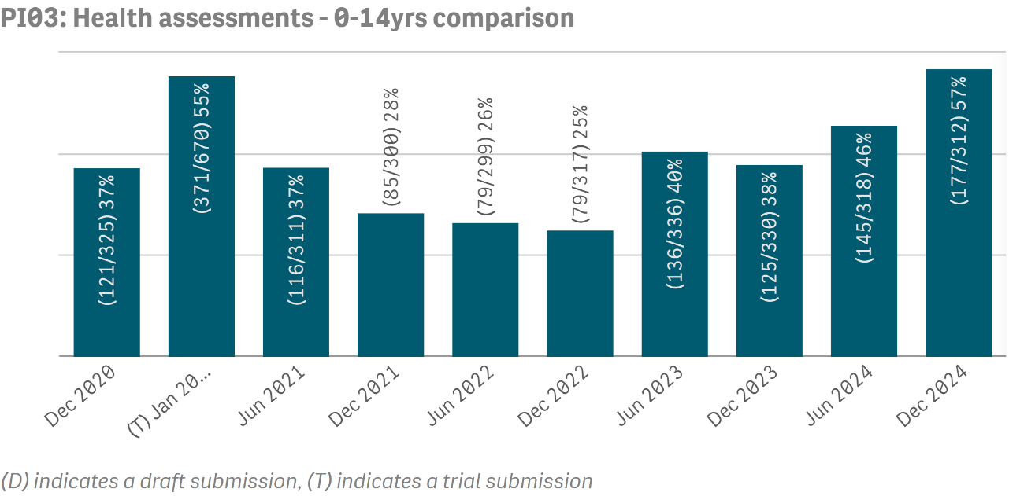
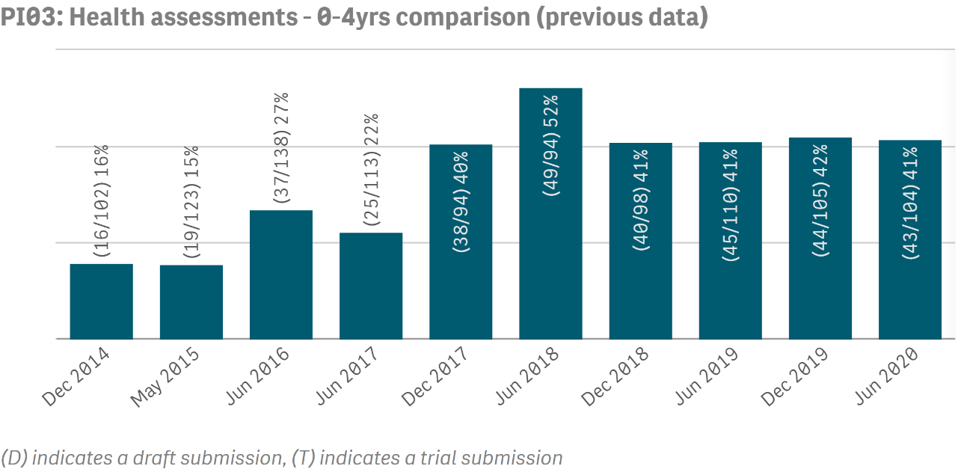
Maternal and Child Health Summary
Process of Care
Updates were made to this indicator in December 2020. This means that data up to June 2020 and data from December 2020 onwards are not directly comparable
PI03- latest data
Proportion of regular clients
with a latest completed
Indigenous health assessment
Focus: Aged 0- 14 years
A higher result is the preferred outcome
PI03- previous data
Proportion of regular clients
with a latest completed
Indigenous health assessment
Focus: Aged 0- 4 years
A higher result is the preferred outcome

Slide 7
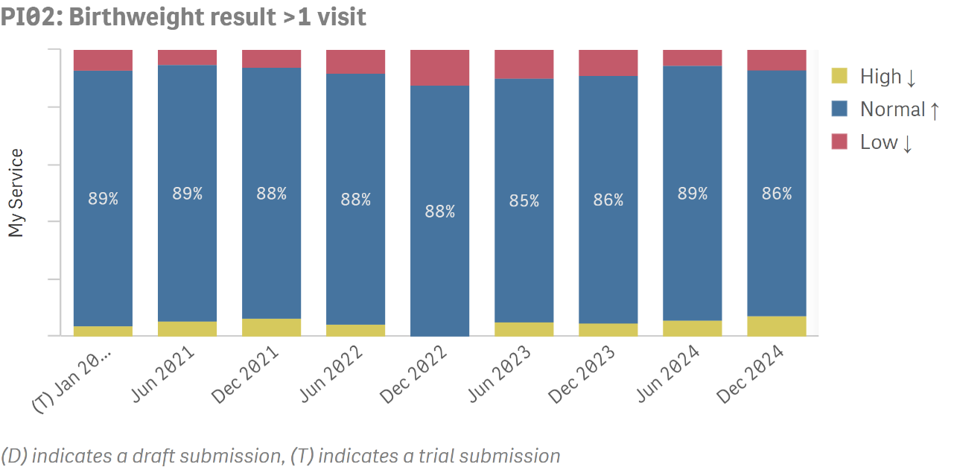
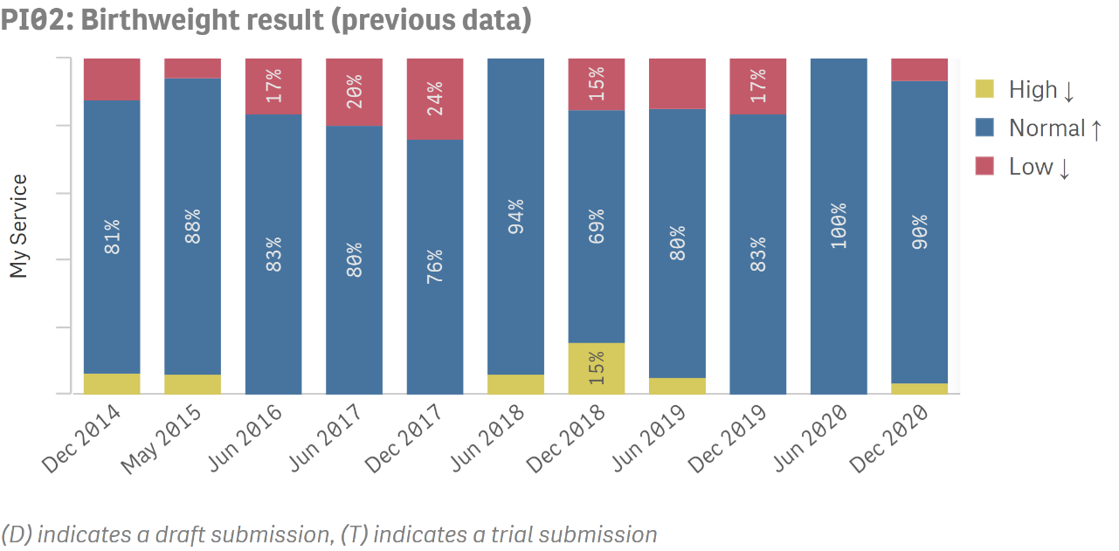
Maternal and Child Health Summary
Outcome
Updates were made to this indicator in June 2021. This means that data up to December 2020 and data from June 2021 onwards are not directly comparable
PI02- latest data
Proportion of Indigenous
babies born within the previous 12 months, who attended the organisation more than once, whose birthweight results were low, normal or high
PI02- previous data
Proportion of Indigenous
babies born within the previous 12 months, whose birthweight results were low, normal or high

Slide 8
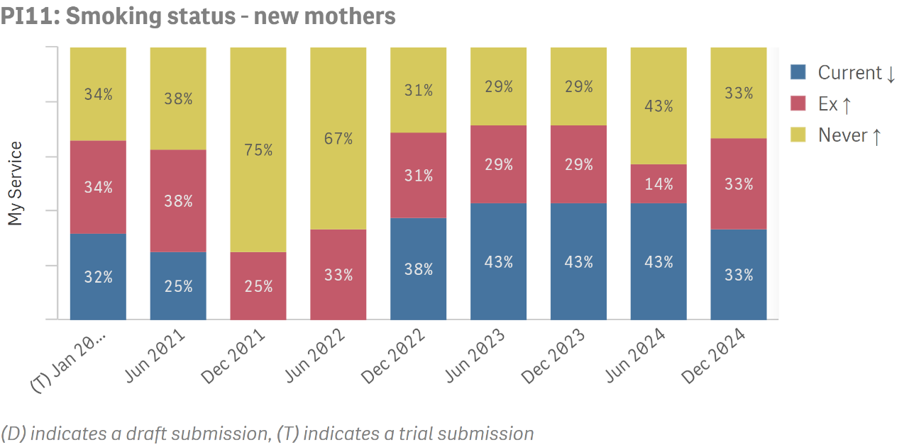
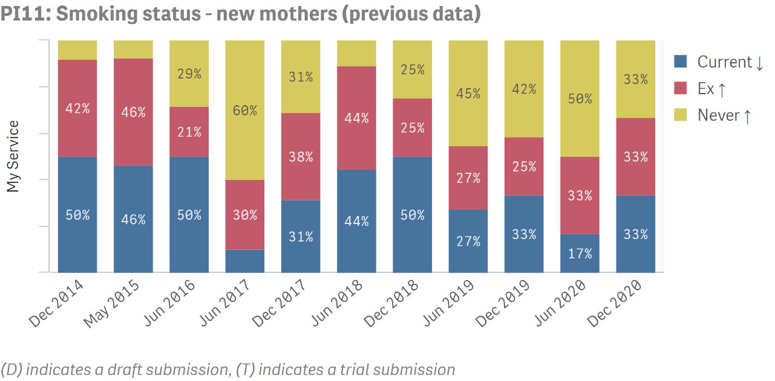
Maternal and Child Health Summary
Outcome
Updates were made to this indicator in June 2021. This means that data up to December 2020 and data from June 2021 onwards are not directly comparable
PI11- latest data
Proportion of regular clients who gave birth within the previous 12 months with a smoking status of ‘current smoker', 'ex-smoker' or 'never smoked'
PI11- previous data
Proportion of regular clients who gave birth within the previous 12 months with a smoking status of ‘current smoker', 'ex-smoker' or ‘never smoked'

Slide 9
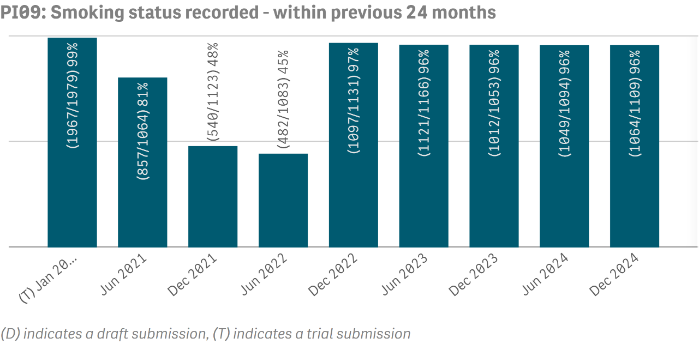
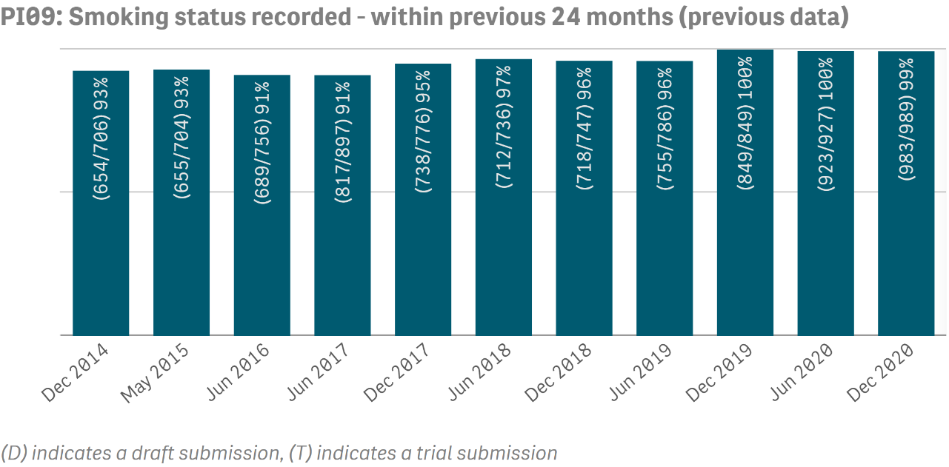
Preventative Health Summary
Process of Care
Updates were made to this indicator in June 2021. This means that data up to December 2020 and data from June 2021 onwards are not directly comparable
PI09- latest data
Proportion of regular clients
whose smoking status has been recorded
A higher result is the preferred outcome
PI09- previous data
Proportion of regular clients
whose smoking status has been recorded
A higher result is the preferred outcome

Slide 10
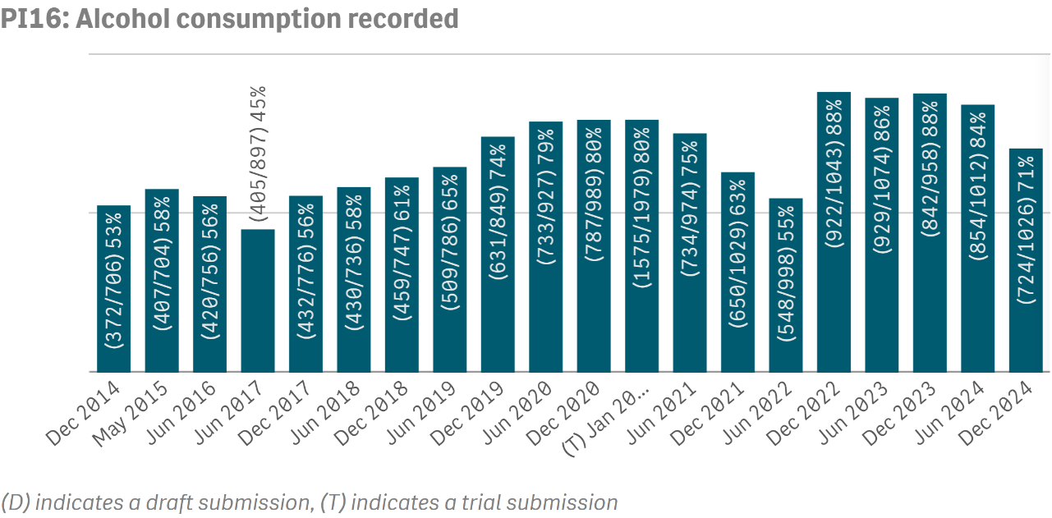
Preventative Health Summary
Process of Care
PI16
Proportion of regular clients whose alcohol consumption
status has been recorded
A higher result is the preferred outcome

Slide 11
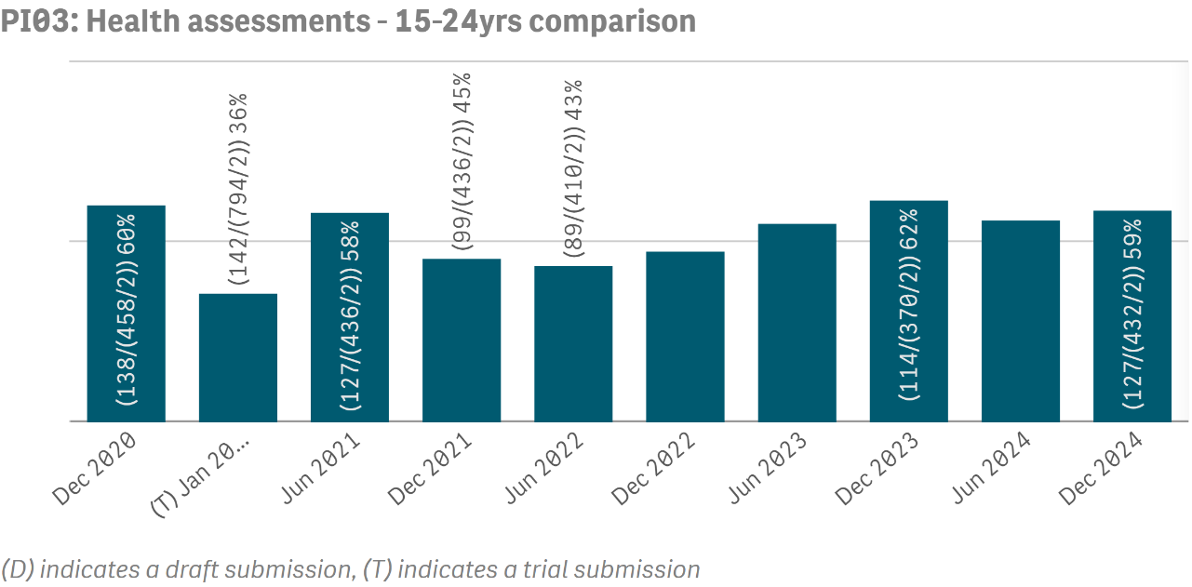
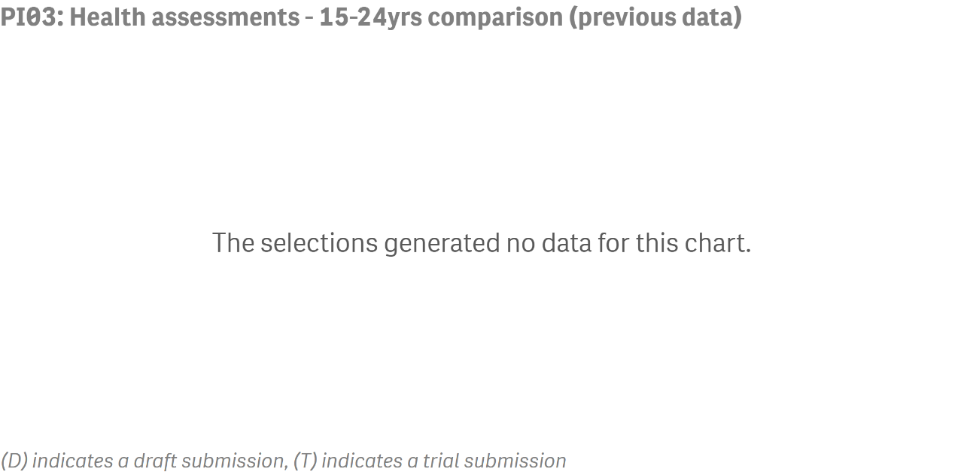
Preventative Health Summary
Process of Care
Updates were made to this indicator in December 2021. This means that data up to June 2021 and data from December 2021 onwards are not directly comparable
PI03- latest data
Proportion of regular clients
for whom an MBS Health
Assessment for Aboriginal and Torres Strait Islander people was claimed
Focus: Aged 15 - 24 years
A higher result is the preferred outcome
PI03- previous data
Proportion of regular clients
for whom an MBS Health
Assessment for Aboriginal and Torres Strait Islander people was claimed
Focus: Aged 15 - 24 years
A higher result is the preferred outcome

Slide 12
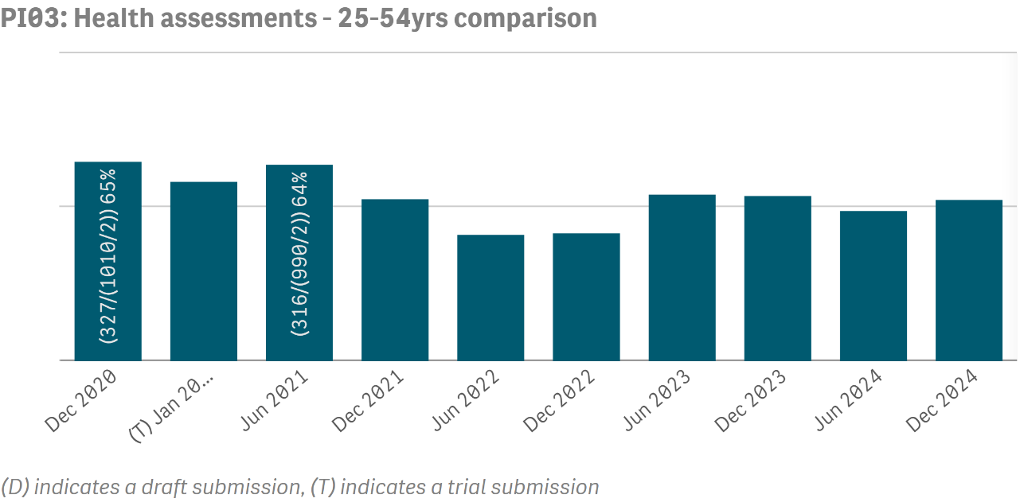
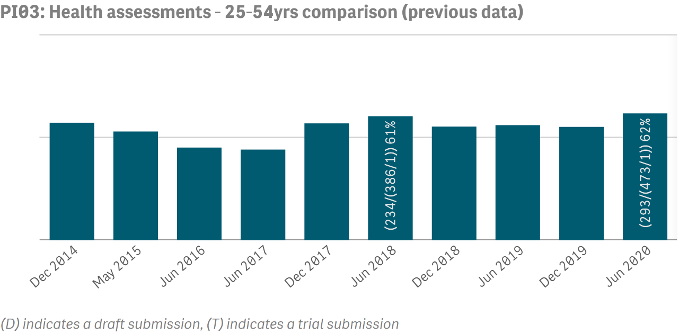
Preventative Health Summary
Process of Care
Updates were made to this indicator in December 2021. This means that data up to June 2021 and data from December 2021 onwards are not directly comparable
PI03- latest data
Proportion of regular clients
for whom an MBS Health
Assessment for Aboriginal and Torres Strait Islander people was claimed
Focus: Aged 25 - 54 years
A higher result is the preferred outcome
PI03- previous data
Proportion of regular clients
for whom an MBS Health
Assessment for Aboriginal and Torres Strait Islander people was claimed
Focus: Aged 25 - 54 years
A higher result is the preferred outcome

Slide 13
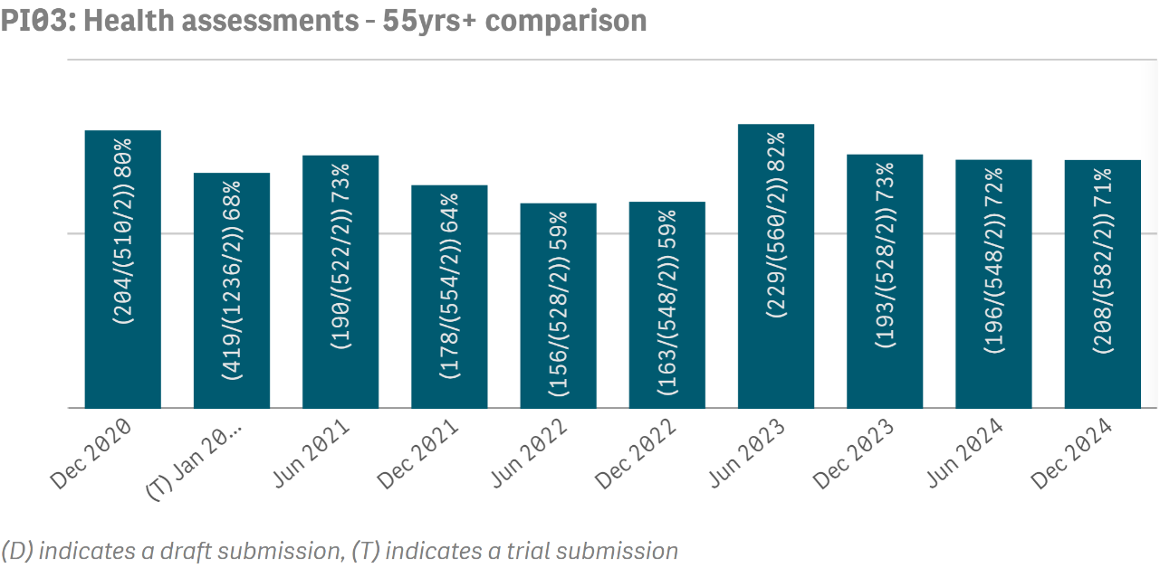
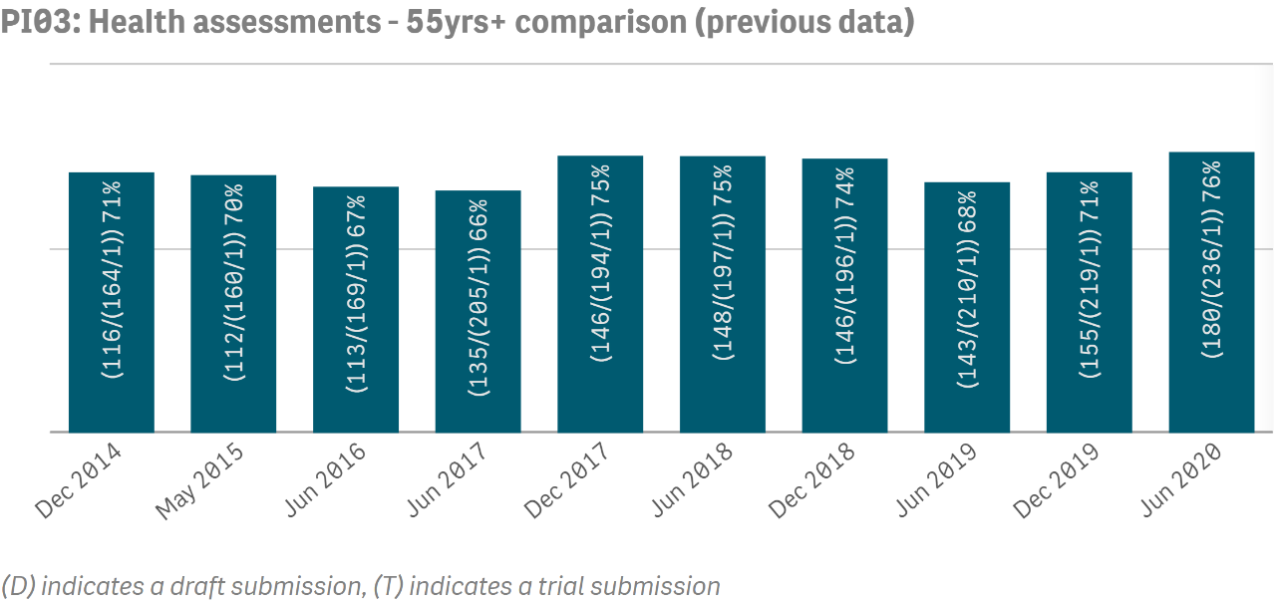
Preventative Health Summary
Process of Care
Updates were made to this indicator in December 2021. This means that data up to June 2021 and data from December 2021 onwards are not directly comparable
PI03- latest data
Proportion of regular clients
for whom an MBS Health
Assessment for Aboriginal and Torres Strait Islander people was claimed
Focus: Aged 55+ years
A higher result is the preferred outcome
PI03- previous data
Proportion of regular clients
for whom an MBS Health
Assessment for Aboriginal and Torres Strait Islander people was claimed
Focus: Aged 55+ years
A higher result is the preferred outcome

Slide 14
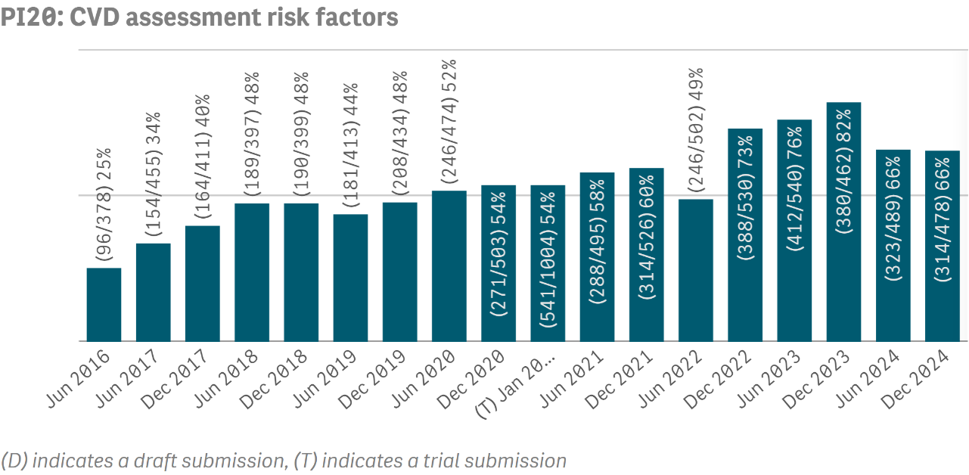
Preventative Health Summary
Process of Care
PI20
Proportion of regular clients
who have had the necessary
risk factors assessed to enable cardiovascular disease (CVD) assessment
A higher result is the preferred outcome

Slide 15
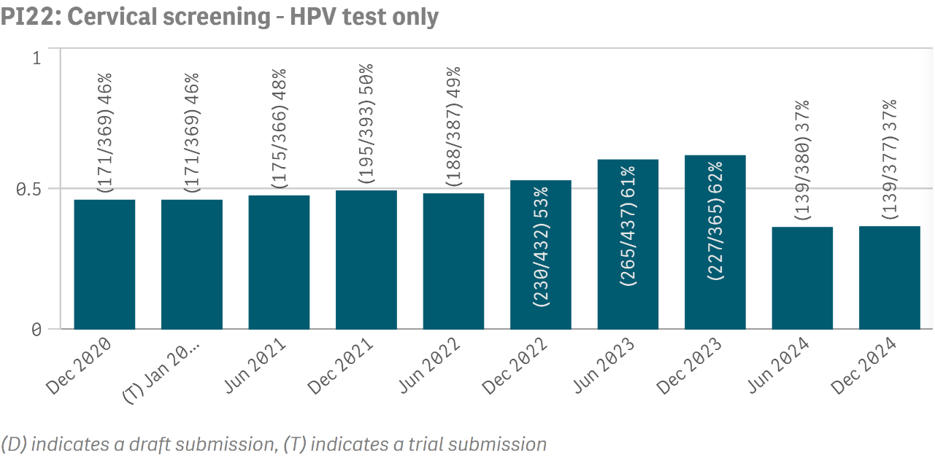
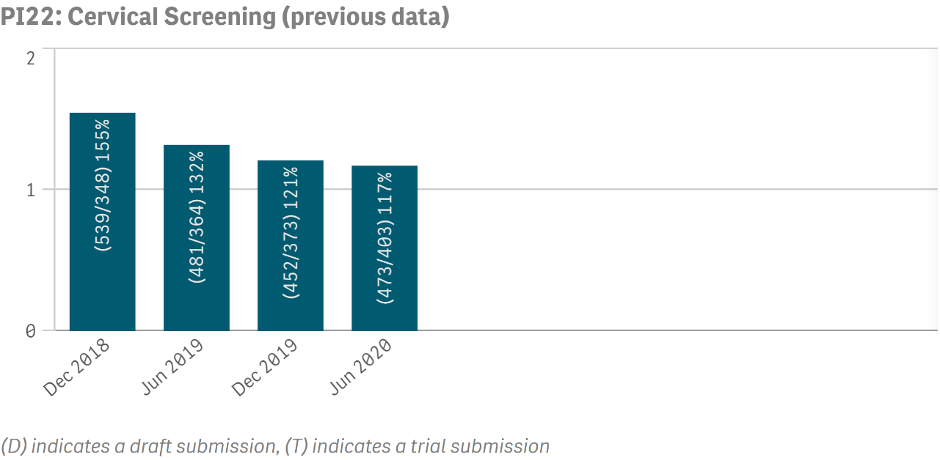
Preventative Health Summary
Process of Care
Updates were made to this indicator in December 2020. This means that data up to June 2020 and data from December 2020 onwards are not directly comparable
PI22- latest data
Proportion of regular clients
who have had a cervical
screening (HPV only) test
A higher result is the preferred outcome
PI22- previous data
Proportion of regular clients
who have had a cervical
screening test
A higher result is the preferred outcome

Slide 16
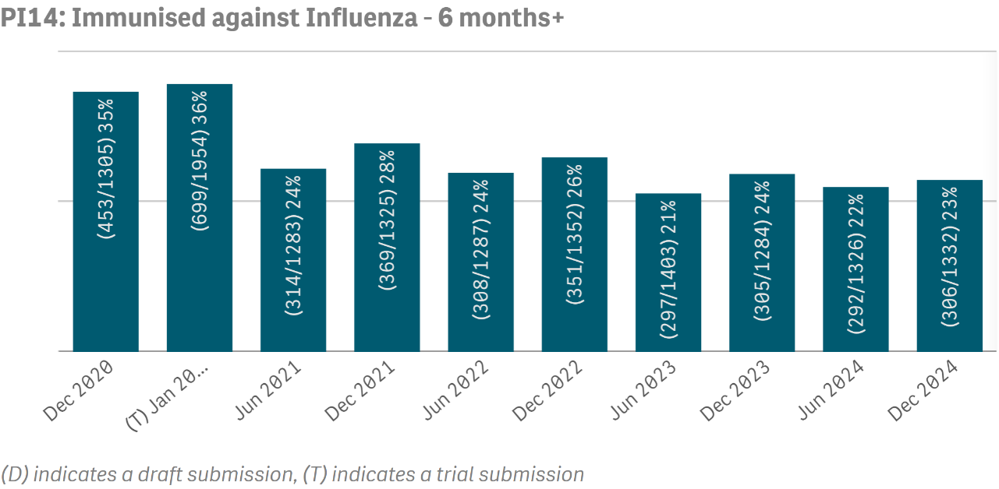
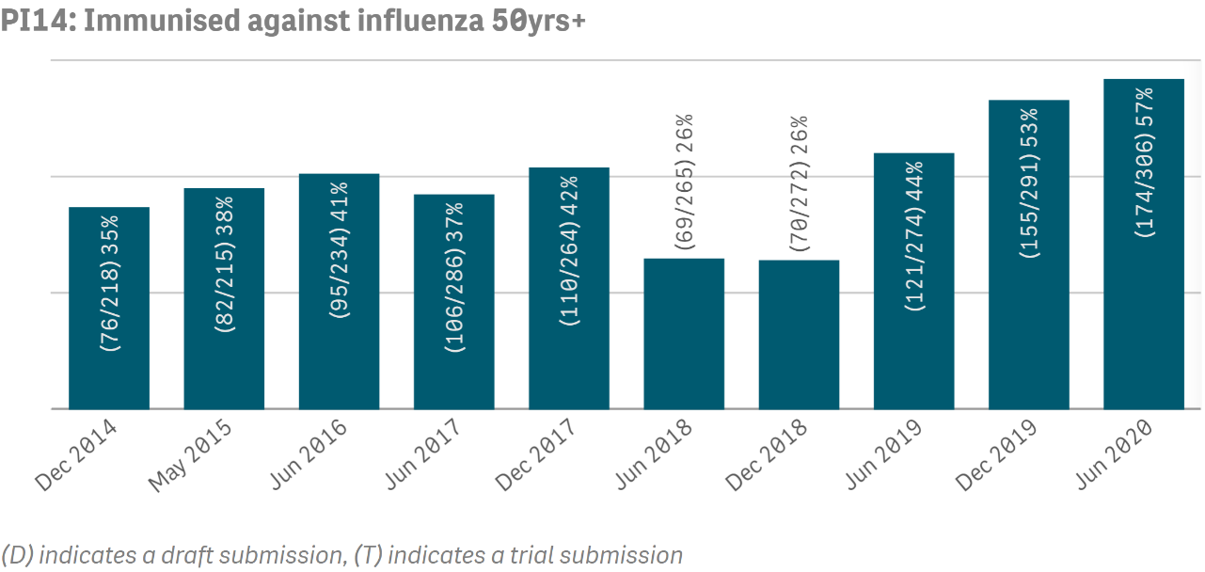
Preventative Health Summary
Process of Care
Updates were made to this indicator in December 2020. This means that data up to June 2020 and data from December 2020 onwards are not directly comparable
PI14- latest data
Proportion of regular clients
aged 6 months and over who are immunised against
influenza
A higher result is the preferred outcome
PI14- previous data
Proportion of regular clients
aged 50 years and over who
are immunised against
influenza
A higher result is the preferred outcome

Slide 17
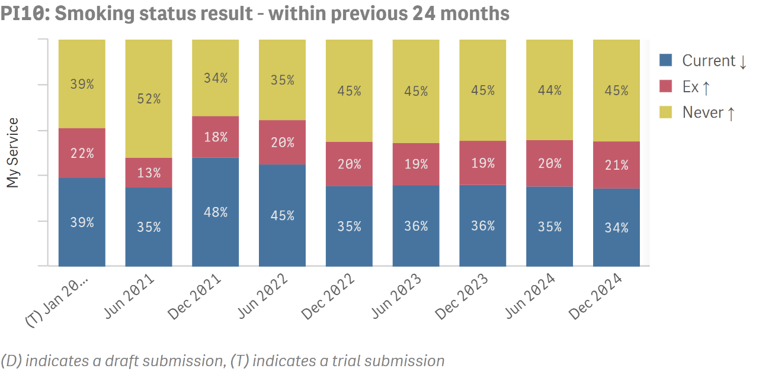
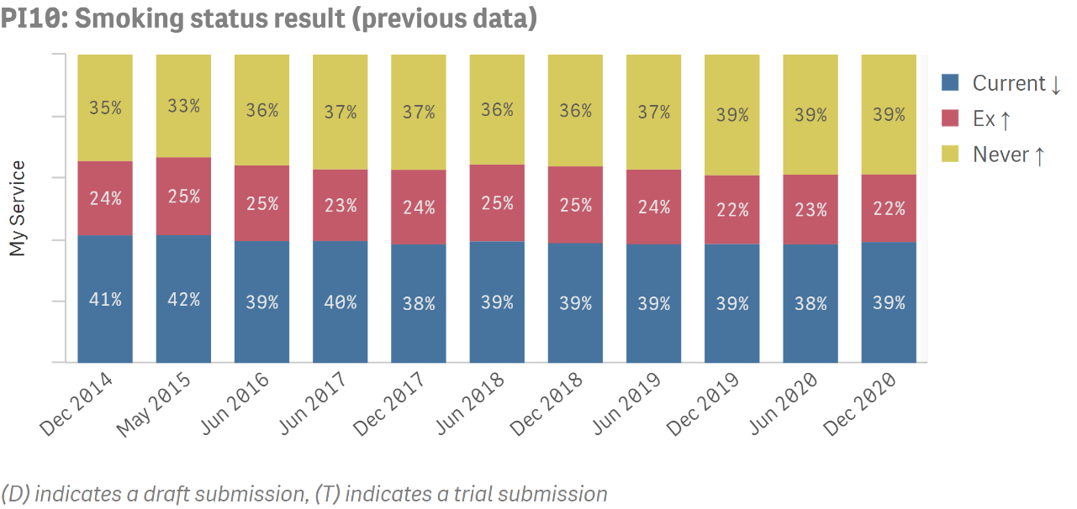
Preventative Health Summary
Outcome
Updates were made to this indicator in June 2021. This means that data up to December 2020 and data from June 2021 onwards are not directly comparable
PI10- latest data
Proportion of regular clients
with a smoking status result of ‘current smoker', 'ex-smoker' or 'never smoked’
within the past 24 months
PI10- previous data
Proportion of regular clients
with a smoking status result of ‘current smoker', 'ex-smoker' or 'never smoked’

Slide 18
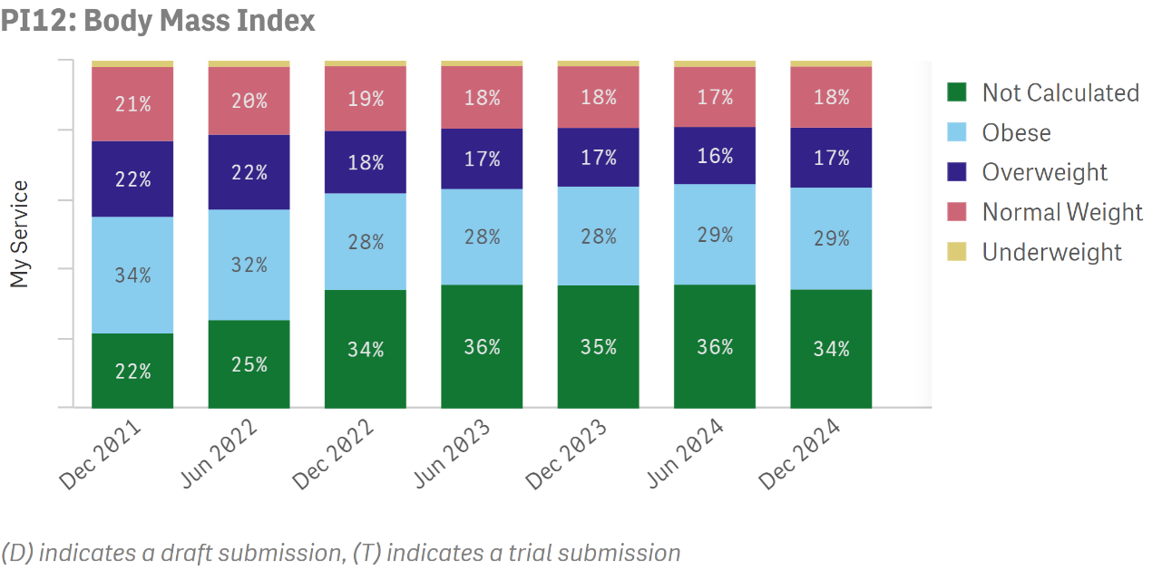
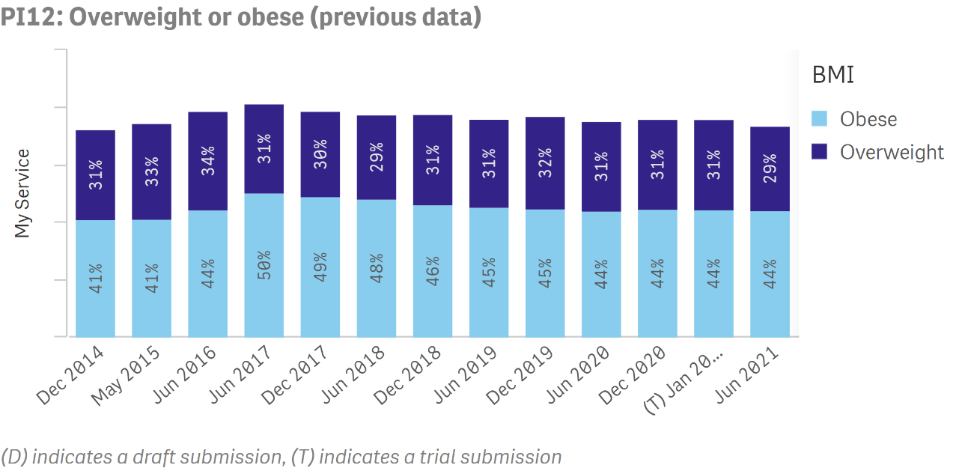
Preventative Health Summary
Outcome
Updates were made to this indicator in December 2021. This means that data up to June 2021 and data from December 2021 onwards are not directly comparable
PI12- latest data
Proportion of regular clients
who have a Body Mass Index (BMI) within specified categories
PI12- previous data
Proportion of regular clients
who are classified as
overweight or obese

Slide 19
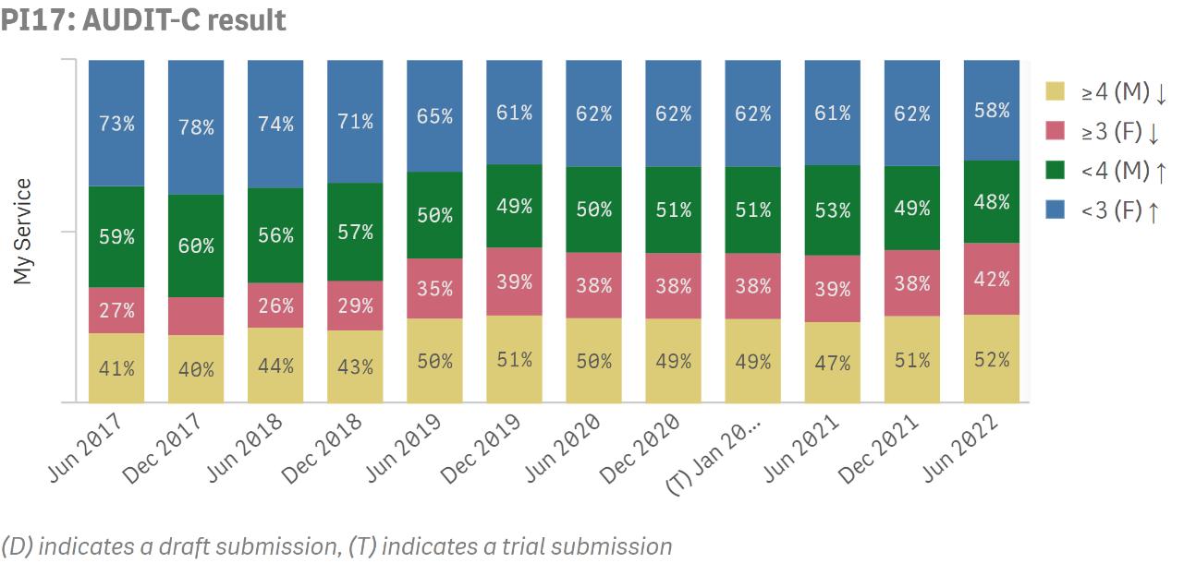
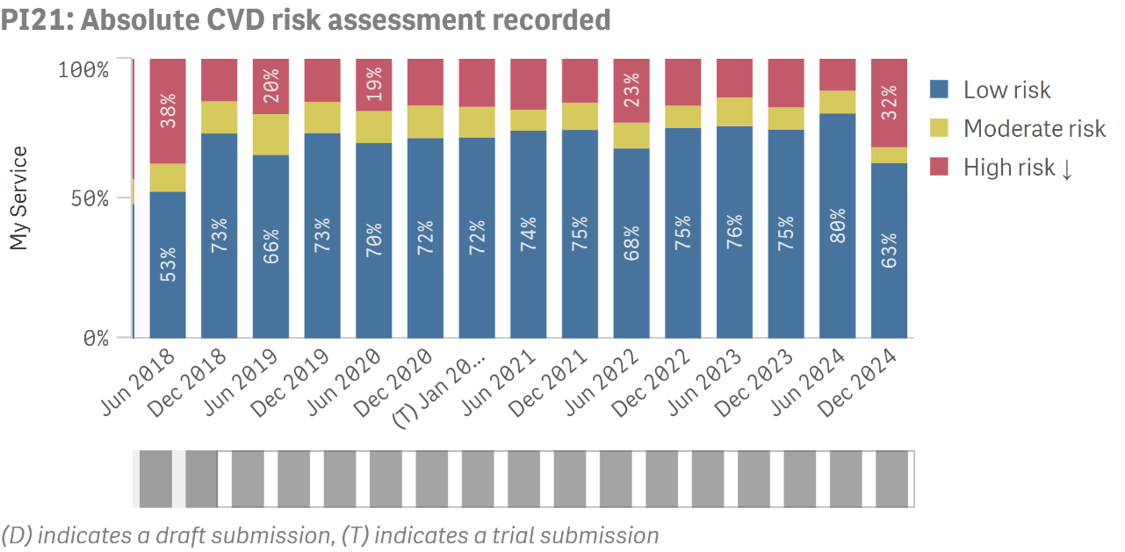
Preventative Health Summary
Outcome
PI17
Proportion of regular clients who had an AUDIT-C with result within specified levels
PI21
Proportion of regular clients
aged 35- 74 years who have
had an absolute cardiovascular disease (CVD) risk assessment with results within specified levels

Slide 20
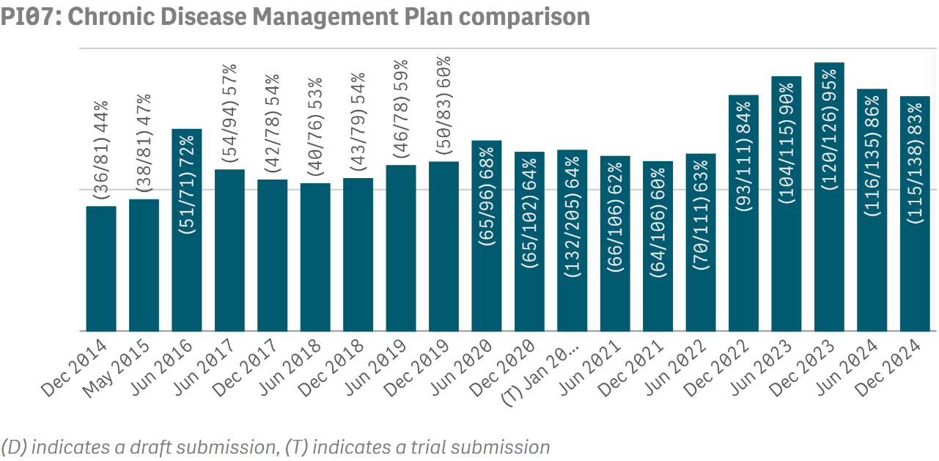
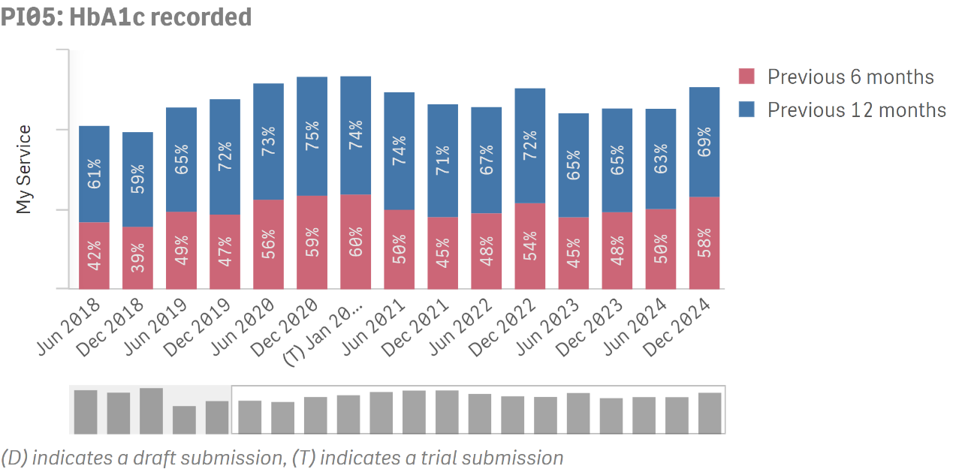
Chronic Disease Management Summary
Process of Care
PI07
Proportion of regular clients with a chronic disease for whom a Chronic Disease Management Plan was
prepared
Focus: Type 2 diabetes
A higher result is the preferred outcome
PI05
Proportion of regular clients with Type 2 diabetes who have had an HbA1c measurement result recorded
A higher result is the preferred outcome

Slide 21
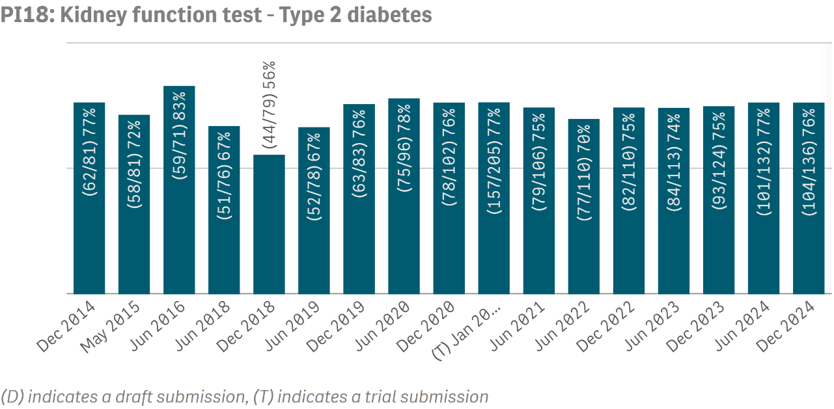
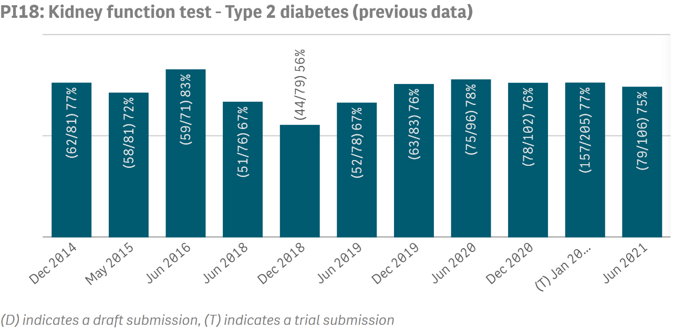
Chronic Disease Management Summary
Process of Care
Updates were made to this indicator in June 2022. This means that data up to December 2021 and data from June 2022 onwards are not directly comparable
PI18- latest data
Proportion of regular clients with a selected chronic disease who have had a kidney function test
Focus: Type 2 diabetes
A higher result is the preferred outcome
PI18- previous data
Proportion of regular clients
with a selected chronic disease who have had a kidney function test
Focus: Type 2 diabetes
A higher result is the preferred outcome

Slide 22
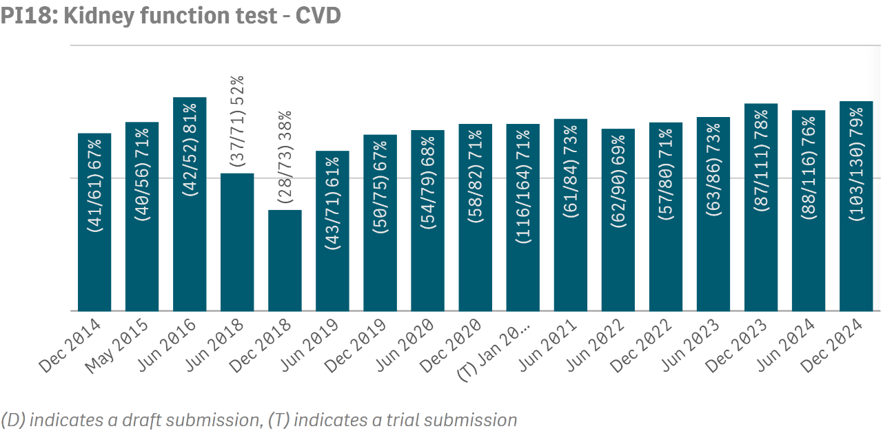
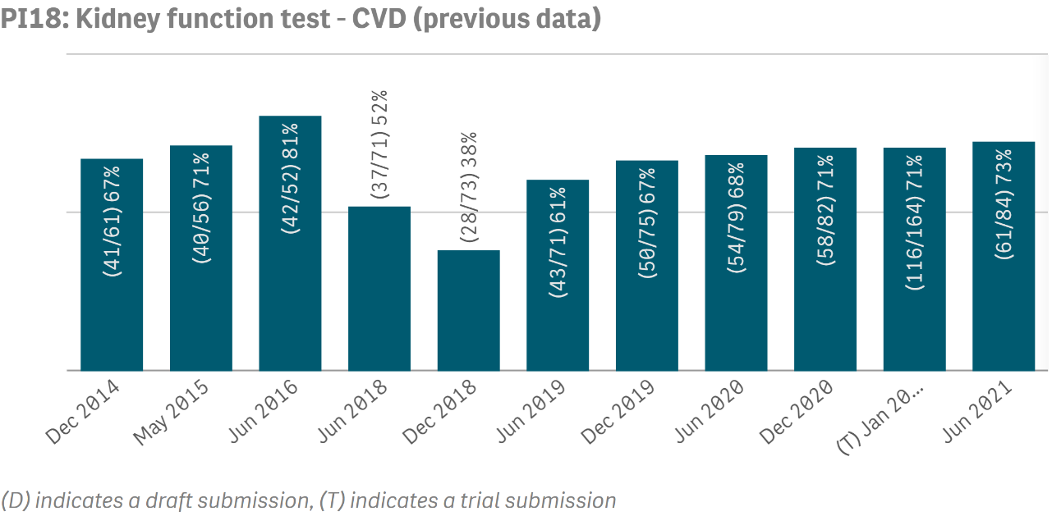
Chronic Disease Management Summary
Process of Care
Updates were made to this indicator in June 2022. This means that data up to December 2021 and data from June 2022 onwards are not directly comparable
PI18- latest data
Proportion of regular clients with a selected chronic disease who have had a kidney function test
Focus: CVD
A higher result is the preferred outcome
PI18- previous data
Proportion of regular clients
with a selected chronic disease who have had a kidney function test
Focus: CVD
A higher result is the preferred outcome

Slide 23
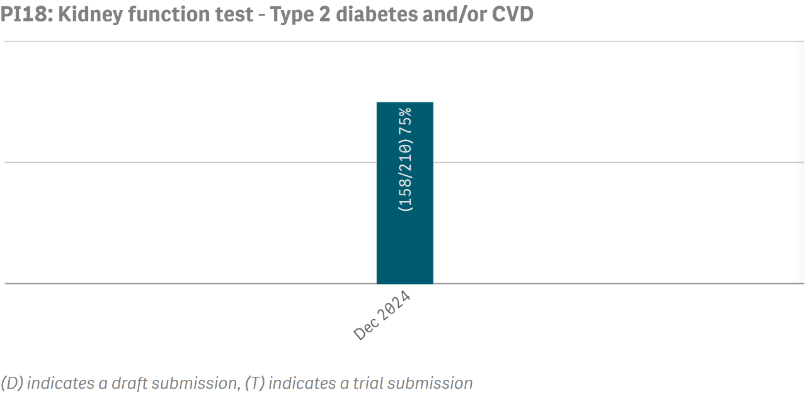
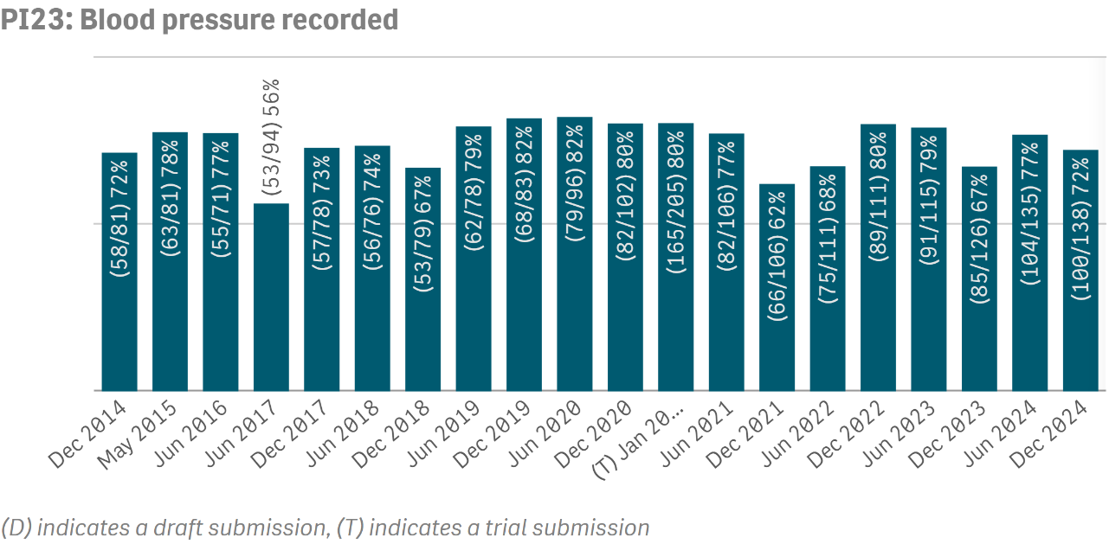
Chronic Disease Management Summary
Process of Care
PI18
Proportion of regular clients with a selected chronic disease who have had a kidney function test
Focus: Type 2 diabetes and/or CVD
A higher result is the preferred outcome
PI23
Proportion of regular clients
with Type 2 diabetes who have had a blood pressure
measurement result recorded
A higher result is the preferred outcome

Slide 24
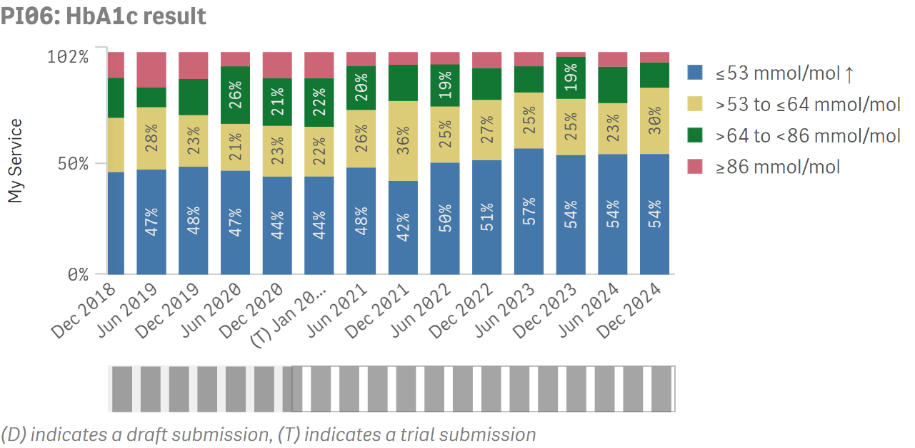
Chronic Disease Management Summary
Outcome
PI06
Proportion of regular clients
with Type 2 diabetes whose
HbA1c measurement result was within a specified level

Slide 25
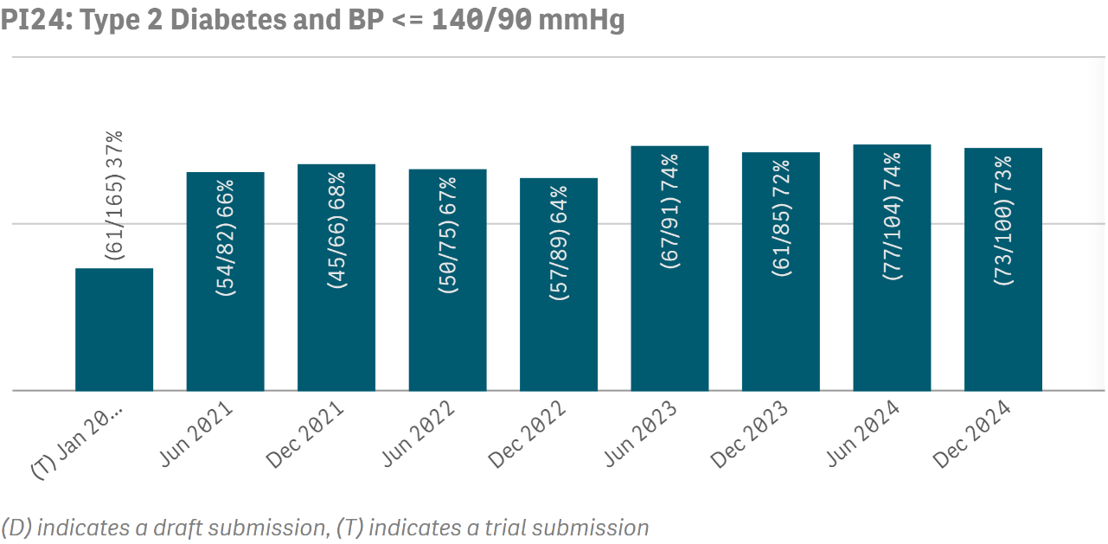
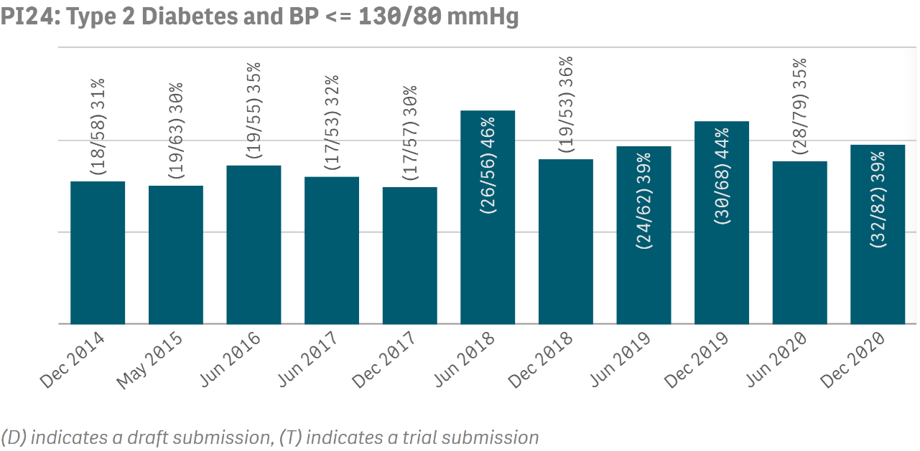
Chronic Disease Management Summary
Outcome
Updates were made to this indicator in June 2021. This means that data up to December 2020 and data from June 2021 onwards are not directly comparable
PI24- latest data
Proportion of regular clients
with Type 2 diabetes whose
blood pressure measurement
result was within specified
categories
Focus: <= 140/90 mmHg
A higher result is the preferred outcome
PI24- previous data
Proportion of regular clients
with Type 2 diabetes whose
blood pressure measurement
result was within specified
categories
Focus: <= 130/80 mmHg
A higher result is the preferred outcome

Slide 26
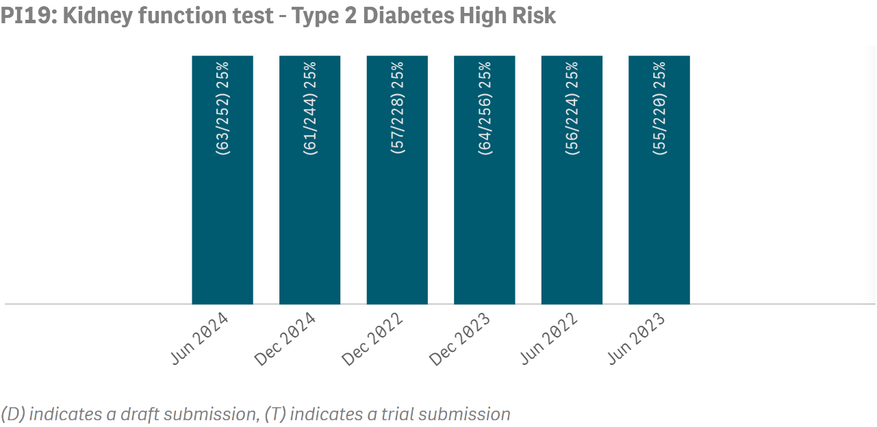
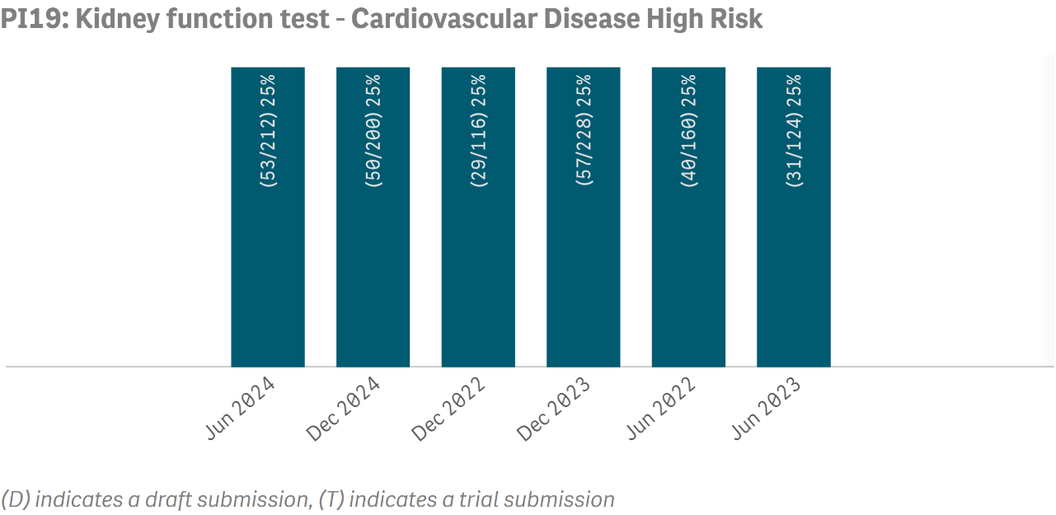
Chronic Disease Management Summary
Outcome
PI19
Proportion of Indigenous
regular clients with a selected
chronic disease who have had a kidney function test result
within a specified level
Focus: Type 2 diabetes, High Risk
A lower result is the preferred outcome
PI19
Proportion of Indigenous
regular clients with a selected chronic disease who have had a kidney function test result within a specified level
Focus: CVD, High Risk
A lower result is the preferred outcome

Slide 27
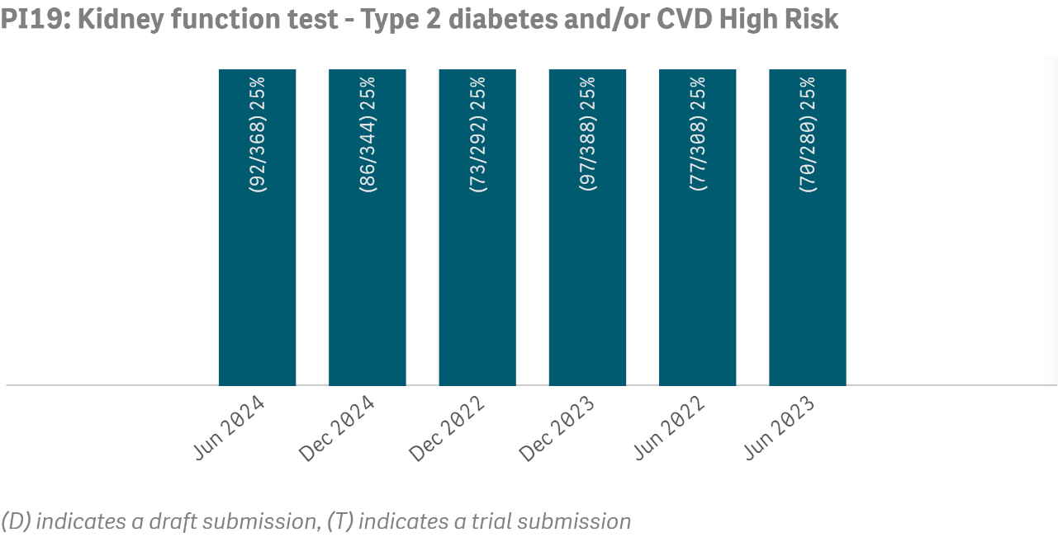
Chronic Disease Management Summary
Outcome
PI19
Proportion of Indigenous
regular clients with a selected
chronic disease who have had a kidney function test result
within a specified level
Focus: Type 2 diabetes or CVD,
High Risk
A lower result is the preferred outcome

